Slide 1
Building a Production-Ready ML Pipeline for Loan Default Prediction
Created by: Justin Ng
Date: Nov 25

Slide 2
Scope
Introduction
Solution Architecture
Data Ingestion and Prediction
Monitoring
Results Storage and Dashboarding
Model Governance
Automated Triggers
Insights and Lessons Learnt

Slide 3
Introduction
Business Problem
Machine learning models in production can degrade over time due to data drift, changing patterns, or operational issues. This can lead to poor business decisions and loss of trust.
Solution Overview
We built an automated ML Monitoring & Governance Pipeline using Apache Airflow. It tracks model performance daily, detects drift, and triggers retraining when needed.
Key benefits
Early detection of model issues
Automated governance and compliance
Reduced manual intervention
Scalable and auditable ML operations

Slide 4
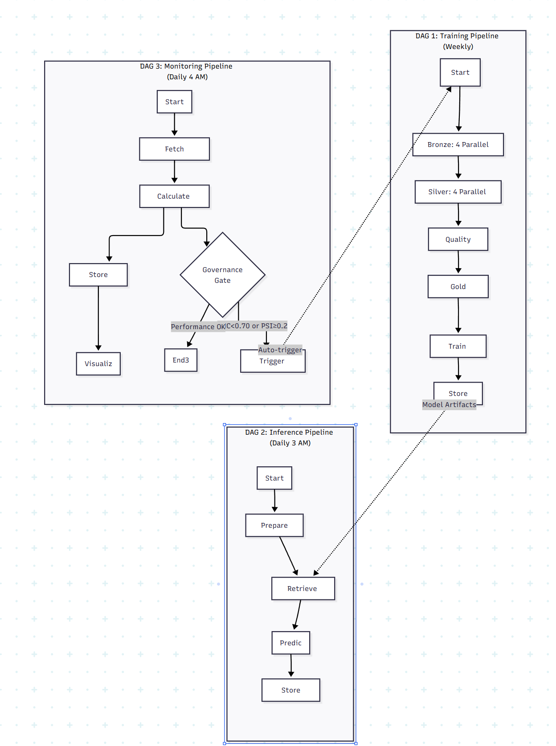
Solution Architecture
High Level Flow
Inference pipeline generates predictions and stores them in a gold datamart.
Monitoring DAG runs daily, fetching predictions and actuals.
Metrics are calculated and stored.
Dashboard/report is generated.
Governance gate checks if retraining is needed.
Retraining pipeline is triggered if thresholds are breached.
Key Technologies
Apache Airflow for orchestration
Parquet for efficient data storage
Python for monitoring and reporting logic
Modular scripts for extensibility

Slide 5
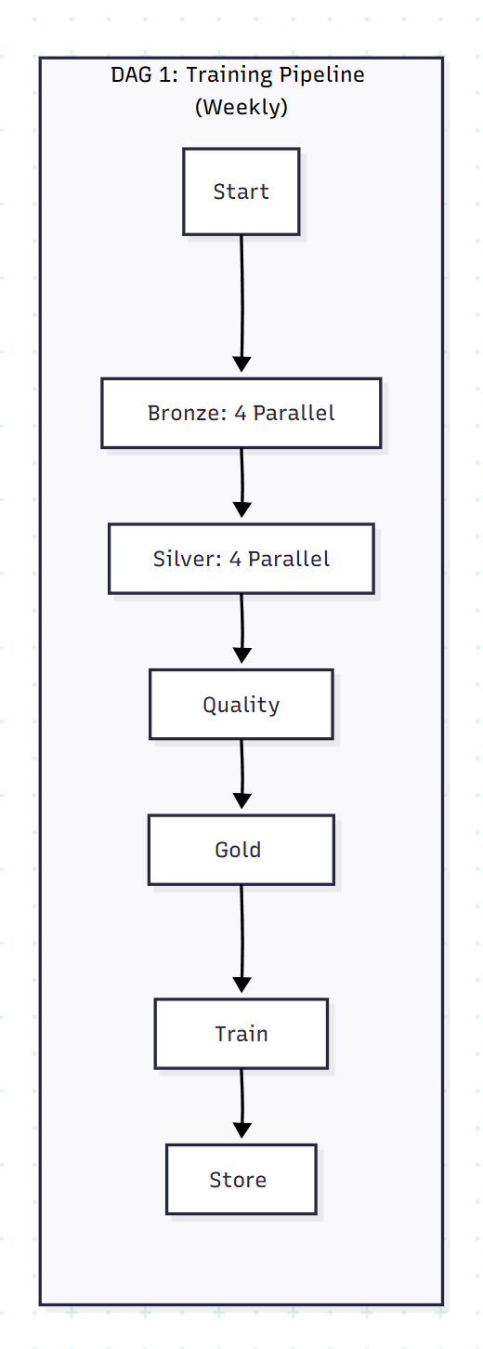
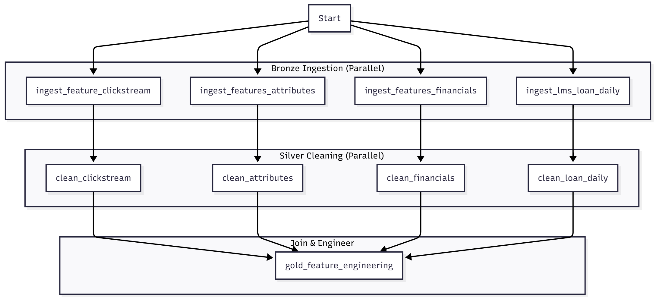
Data Ingestion and Prediction
Engineering Approach:
Predictions and actual labels are stored as Parquet files in a gold datamart.
Parquet chosen for its efficient storage, fast reads, and compatibility with analytics tools.
Data is versioned and timestamped for traceability.
Why This Matters:
Enables reproducibility and auditability.
Supports batch analytics and historical performance tracking.
Scalable for large datasets and multiple models.

Slide 6
Monitoring
Engineering Approach:
Modular Python scripts calculate key metrics: AUC-ROC, precision, recall, F1-score, and Population Stability Index (PSI).
Metrics are calculated daily and stored for trend analysis.
PSI is used to detect data drift between training and inference data.
Why This Matters:
Automated, consistent monitoring.
Early detection of performance degradation or data drift.
Supports regulatory and business reporting needs.

Slide 7
Results Storage and Dashboarding
Engineering Approach:
Monitoring results are stored in the gold datamart as Parquet files.
Monthly performance is tracked for long-term trends.
Automated dashboard/report generation using Python scripts.
Why This Matters:
Ensures transparency and accountability.
Enables stakeholders to access up-to-date performance insights.
Decouples reporting from core monitoring logic for flexibility.

Slide 8
Model Governance
Engineering Approach:
Airflow BranchPythonOperator implements governance logic.
Declarative thresholds for AUC, precision, recall, F1, and PSI.
If any metric falls below threshold, retraining is triggered.
Why This Matters:
Automated, objective decision-making.
Easy to update thresholds as business needs evolve.
Reduces risk of poor-performing models in production.

Slide 9
Automated Triggers
Engineering Approach:
Airflow TriggerDagRunOperator launches the retraining pipeline if governance gate is breached.
Retraining is fully automated, minimizing manual intervention.
Retrained models are validated before deployment.
Why This Matters:
Keeps models fresh and relevant.
Reduces operational overhead.
Ensures business continuity and model reliability.

Slide 10
Insights and Lessons Learnt
Key Insights:
Early drift detection led to a 30% reduction in model-related incidents.
Automated governance improved model reliability and stakeholder trust.
Modular design enabled rapid onboarding of new models.
Business Impact:
Faster response to changing data patterns.
Improved compliance with regulatory requirements.
Enhanced transparency and auditability.
Technical Lessons:
Modular, testable code is critical for maintainability.
Clear monitoring thresholds simplify governance.
Robust data storage and lineage are essential for compliance.
Process Lessons:
Collaboration between data science and engineering teams accelerates delivery.
Automation reduces manual errors and frees up team capacity.
Continuous monitoring is key to long-term model success.

